Slide 1

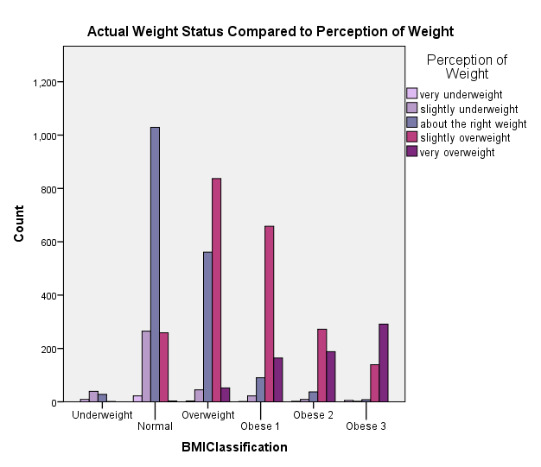
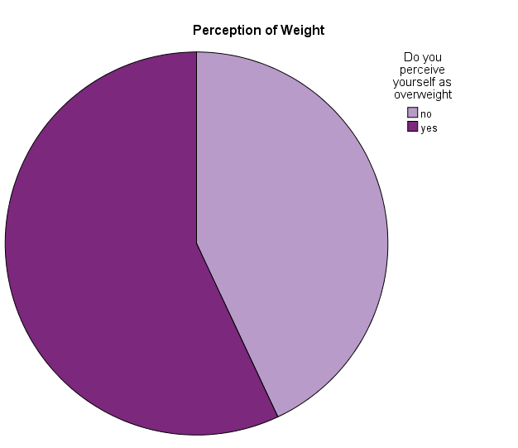
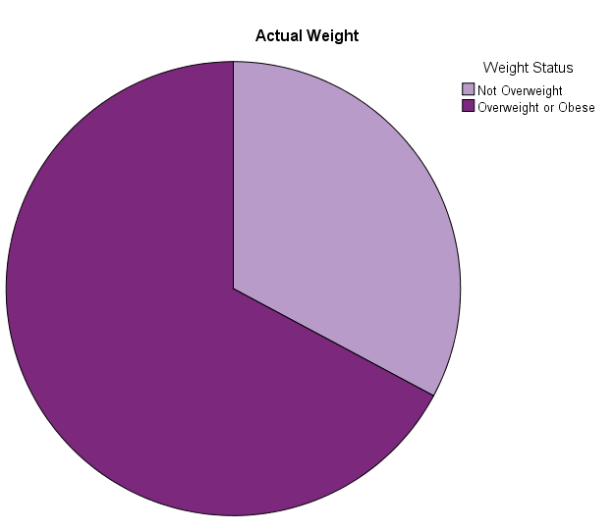
The Relationship Between BMI and Weight Perception
Amie Patrick
California State University, Chico
Introduction
The United States has the highest prevalence of overweight adults when compared to the rest of the world. In fact, the prevalence of US overweight and obese adults age 20 and over is, 70.7% (CDC.gov). Obesity and overweight status is associated with diseases such as diabetes and coronary heart disease, both of which can greatly decrease one’s quality of life and may also lead to death (Park, 2011). The decision for obese or overweight individuals to attempt weight-loss is multifactorial, with many components working together to catalyze a person into the quest for weight-loss and/or health promotion. It has been proposed that one factor that impacts a person’s decision to lose weight is their perception of their current weight status (Yost, 2010). Therefore, accurate weight perception is an important factor in whether an overweight or obese individual attempts weight loss. One article found self-reported weight accuracy to be very high, detecting no significant difference between participants self-reported BMI and their actual BMI (Xie, 2014). However, different research has found that 20% of overweight or obese individuals had inaccurate weight perception (Yost, 2010).These contradictory conclusions regarding which factors make a person more prone to underreport, overreport, or accurately report their perception of weight, show a need for further investigation into the relationship between actual BMI and weight perception. With the high rates of overweight and obese individuals in the US, new methods for weight loss promotion are warranted. For an overweight or obese individual to recognize they need to lose weight, an accurate perception of weight is useful. However, it remains unclear the rates at which overweight or obese individuals misreport their weight, and if gender or other factors may impact the rates of misreporting.
Objectives
To determine the relationship between BMI and weight perception.
To determine the relationship between BMI >25 and accurate weight perception.
Hypotheses
1) There will be a significant relationship between BMI and weight perception.
2) Overweight or Obese participants will misperceive their weight more than normal weight participants.
Sample Characteristics
Will add this before printing
Results
Weight Perception vs Weight Status
 |  |  | Do You Perceive Yourself as Overweight? |  | Total
 |  |  | No | yes
Weight Status | Not Overweight | Count | 1392 | 263 | 1655
 |  | % within Weight Status | 84.1% | 15.9% | 100.%
 | Overweight or Obese | Count | 785 | 2601 | 3386
 |  | % within Weight Status | 23.2% | 76.8% | 100.%
 |  | % of Total | 15.6% | 51.6% | 67.2%
BMI was significantly associated with perception of health (Chi-square = 1682, p<.001).
The odds of perceiving oneself as overweight were 1,957 times higher in obese class 3 individuals when compared to underweight individuals after controlling for perception of health (OR=1957 CI 254,15061 P<.001).
BMI | BMI Classification
<18.5 | Underweight
18.5-24.9 | Normal Weight
25-29.9 | Overweight
30-34.9 | Obese I
35-39.9 | Obese II
>40 | Obese III
The odd of perceiving oneself as overweight were 691 times higher in obese class 2 individuals when compared to underweight individuals after controlling for perception of health OR=691 CI 94, 591).
23% of participants who were classified as overweight or obese perceived themselves as not overweight.
Results
52% of those who perceived themselves as very underweight actually had a BMI that is classified as “normal weight”.
31% of those who were classified as obese class 3, perceived themselves to be slightly overweight.
Conclusion
The odds of perceiving oneself as overweight was much greater for participants who were in the obese class 3 category when compared to the underweight category.
23 participants who were overweight or obese perceived themselves as not overweight. This population may be at risk for obesity related diseases, yet they are unaware that they are overweight or obese, which may cause them to be unaware of their possible health risks.
67% of participants were overweight or obese. This closely aligns with the national average of 70.7% as reported by the CDC.
A major limitation to this study was the lack ethnicity data, as “normal” BMI can differ greatly among different ethnic groups.
Implications for Future Research: The results of this study show that more research, specifically qualitative research, is needed to determine what causes an overweight or obese person perceive themselves as normal weight or underweight. The goal of future research would be to determine the cause for weight misperception, so as to design interventions that address the factors that cause weight misperception.
Methods
67% of participants had a BMI that classifies them as overweight or obese, while only 57% of participants perceived themselves to be slightly overweight or very overweight.
Study Design: This research project utilized a cross-sectional observational study, with a sampling of 5041 participants from the Add Health wave IV, which was collected between 2008 and 2009.
Measurement Instruments: Study participants completed a very extensive questionnaire and interview process. In addition, anthropometrics and biospeciman samples were collected from study participants.
Variables:
BMI categories were dichotomized into “not overweight” or “overweight or obese”, in addition this variable was also ordinal with 6 levels ranging from underweight to obese class 3.
Perception of weight was categorical with 5 levels ranging from very underweight to very overweight, and binary with two levels, “not over weight” or “overweight/obese”.
Perception of health was categorical with 5 levels ranging from poor to excellent.
References
Centers for Disease Control. National Center for Health Statistics. https://www.cdc.gov/nchs/fastats/obesity-overweight.htm.
Park, E. (2011). Overestimation and underestimation: Adolescents' weight perception in comparison toBMI-based weight status and how it varies across socio-demographic factors. The Journal of SchoolHealth, 81(2), 57-64.
Xie, Y. J., Ho, S. C., Liu, Z. M., & Hui, S. S. (2014). Comparisons of Measured and Self-Reported Anthropometric Variables and Blood Pressure in a Sample of Hong Kong Female Nurses. Plos ONE, 9(9), 1-8.
Yost, Jennifer, Krainovich-Miller, Barbara, Budin, Wendy, & Norman, Robert. (2010). Assessing weightperception accuracy to promote weight loss among U.S. female adolescents: A secondary analysis. BMCPublic Health, 10, 465.

